Slide 1


Use Case:
Actor:
Grade
Application
CoR Member

Slide 2
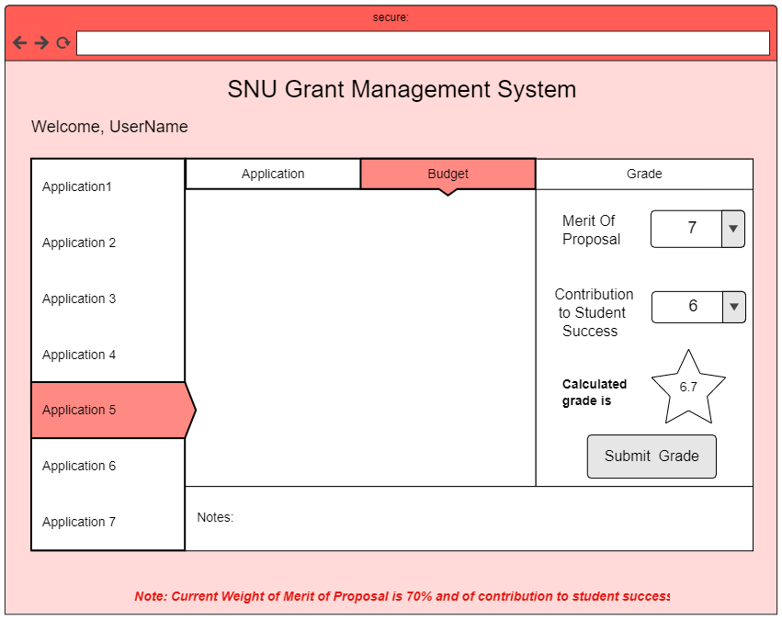
Use Case:
Grade Application
Actor:
CoR Member
Application Status: Pending Evaluation
Green, Alison
Frederick, Cody
Patel, Priya
Rain, Thomas
Tobias, Robert
Smith, John
Tobias, Robert
Taurus, Andrew
Yasmin, Jennifer

Slide 3
Use Case:
Grade Application
Actor:
CoR Member
Application Status: Pending Evaluation
Green, Alison
Frederick, Cody
0
1
2
3
4
5
6
7
Patel, Priya
Rain, Thomas
Tobias, Robert
Smith, John
Tobias, Robert
Taurus, Andrew
Yasmin, Jennifer

Slide 4
Use Case:
Grade Application
Actor:
CoR Member
Application Status: Pending Evaluation
Green, Alison
Frederick, Cody
0
1
2
3
4
5
6
7
Patel, Priya
Rain, Thomas
Tobias, Robert
Smith, John
Tobias, Robert
Taurus, Andrew
Yasmin, Jennifer

Slide 5
Use Case:
Grade Application
Actor:
CoR Member
Application Status: Pending Evaluation
Green, Alison
Frederick, Cody
Patel, Priya
Rain, Thomas
Tobias, Robert
Smith, John
Tobias, Robert
Taurus, Andrew
Yasmin, Jennifer

Slide 6
Use Case:
Grade Application
Actor:
CoR Member
Application Status: Pending Evaluation
Green, Alison
Frederick, Cody
Patel, Priya
Rain, Thomas
0
1
2
3
4
5
6
7
Tobias, Robert
Smith, John
Tobias, Robert
Taurus, Andrew
Yasmin, Jennifer

Slide 7
Use Case:
Grade Application
Actor:
CoR Member
Application Status: Pending Evaluation
Green, Alison
Frederick, Cody
Patel, Priya
Rain, Thomas
0
1
2
3
4
5
6
7
Tobias, Robert
Smith, John
Tobias, Robert
Taurus, Andrew
Yasmin, Jennifer

Slide 8
Use Case:
Grade Application
Actor:
CoR Member
Application Status: Pending Evaluation
Green, Alison
Frederick, Cody
Patel, Priya
Rain, Thomas
Tobias, Robert
Smith, John
Tobias, Robert
Taurus, Andrew
Yasmin, Jennifer

Slide 9

Use Case:
Grade Application
Actor:
CoR Member
Application Status: Grade Submitted
Green, Alison
The grade for John Smith’s application has been submitted successfully.
Frederick, Cody
Grade Submitted
Patel, Priya
Rain, Thomas
OK
Tobias, Robert
Smith, John
Tobias, Robert
Taurus, Andrew
Yasmin, Jennifer

Slide 10
Use Case:
Grade Application
Actor:
CoR Member
Application Status: Grade Submitted
Green, Alison
Frederick, Cody
Patel, Priya
Rain, Thomas
Tobias, Robert
Smith, John
Tobias, Robert
Taurus, Andrew
Yasmin, Jennifer

